Slide 1
Procedural Generation
David Powell

Slide 2
What is PGC?
Procedurally Generated Content is when you use a computer to semi-randomly create content. It can be used in a variety of fields, such as: science, film, music, and games.

Slide 3
Teleological vs. Ontogenetic
Teleological is the approach where you create an accurate physical model of the environment and the processes that govern them, then you run the simulation and observe the results.
Ontogenetic is the approach where you know the end result and then attempt to reproduce the result with algorithms.

Slide 4
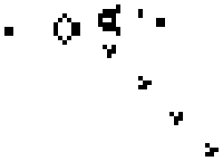
Teleological
Artificial Life
Dynamic Weather
Fire Propagation
Fluid Dynamics
Genetic Algorithm
Rain Drop Algorithm
Reaction-Diffusion System: Chemistry

Slide 5
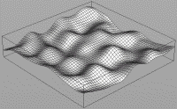
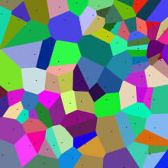
Ontogenetic
Diamond-Square Algorithm: Generating heightmaps
L-System: Plant generation
Perlin Noise: Adds layers of noises. Higher noises are more precise, but are less weighted.
Simplex Noise: A redesign of Perlin Noise, by Ken Perlin.
Voronoi Diagram: organic looking division rather than rectangular or circular systems.

Slide 6
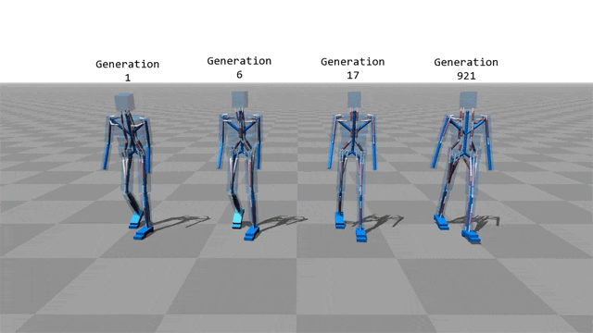
Science:
Automobiles
Biomechanics
Artificial Intelligence
Data Generation

Slide 7
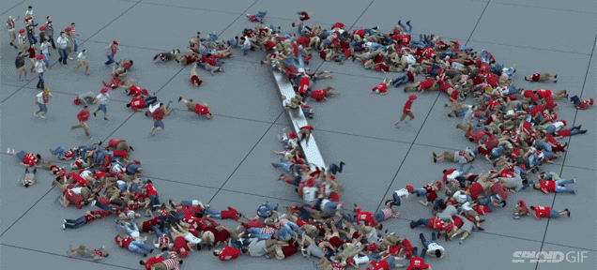
Film:
Crowd Movement
Environmental Noise
Armies/Battles
Background Elements

Slide 8
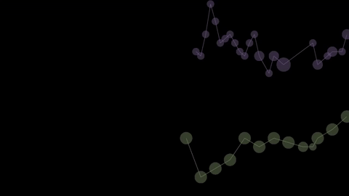
Music:
Instruments
Tempo
Voices

Slide 9
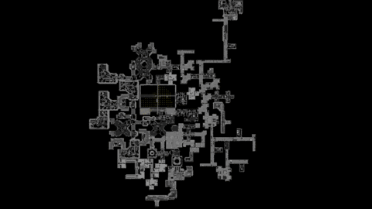
Games:
Environment
Enemy Placements
Weapons and Armor

Slide 10
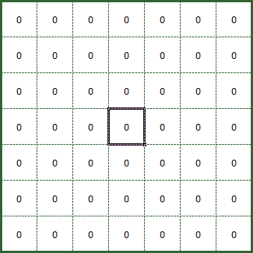
Drunk Walk Algorithm
Used to create a winding path
Imagine a drunk person walking where you’re not sure what direction they could go
Edit to favor certain directions

Slide 11
// Adapted from Dan Shiffman, natureofcode.com
var Walker = function() {
this.x = width/2;
this.y = height/2;
};
Walker.prototype.display = function() {
stroke(0, 0, 0);
point(this.x, this.y);
};
// Randomly move up, down, left, right, or stay in one place
Walker.prototype.walk = function() {
var choice = floor(random(4));
if (choice === 0) {
this.x++;
} else if (choice === 1) {
this.x--;
} else if (choice === 2) {
this.y++;
} else {
this.y--;
}
};
var w = new Walker();
var draw = function() {
w.walk();
w.display();
};
Source: Khan Academy

Slide 12
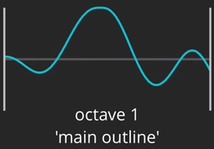
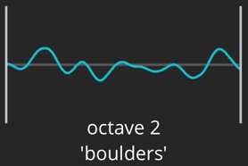
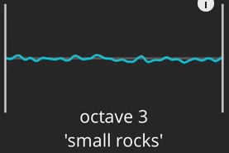
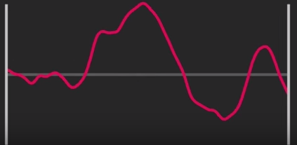
Perlin Noise
Add layers of noise
Higher layers are more precise
Higher layers are weighted less

Slide 13
Perlin Noise Code

Slide 14
Sources:
http://pcg.wikidot.com/
http://www-cs-students.stanford.edu/~amitp/gameprog.html
https://www.khanacademy.org/computing/computer-programming/programming-natural-simulations/programming-randomness/a/random-walks
https://github.com/wwwtyro/perlin.js/blob/master/perlin.js

